Slide 1
DecodeEV Hackathon
Team - Xcellerator

Slide 2
We are aware about EV adaptation limitation and challenges faced by Consumers and Manufacturers (OEMs)

Slide 3
But there are other major stakeholders as well who are also struggling to adapt to this green transportation revolution
Automobile Insurance Companies
Automobile Finance Companies
Automobile Resellers
Renting Companies
Government Regulatory Organizations

Slide 4
Automobiles with conventional fuel (Petrol & Diesel) are provides years of data and it is easy to figure out the various cost around them such as –
Life Cycle Cost (Running Cost)
Insurance Premium Cost (A standard using Cubic Capacity CC)
Deprecation Cost
Whereas, EV brings out challenges such as finding a way to price EV risk into mathematical models. This stems primarily from the non-availability of data, as no one has any previous experience in EVs and in determining the risks it entails. Insurance is all about averaging out risks and the premium is fixed on the basis mathematical models and years of data. At a relatively lower scale, this isn’t a as much of a problem, but as the shift to EVs hastens, pricing issues will become more prominent.
Ref https://bfsi.economictimes.indiatimes.com/news/insurance/as-evs-catch-fire-insurance-firms-face-pricing-risk/91463960

Slide 5
Following are the field data/factors which play significant role in risk/price modelling of an EV Vehicle in Usage –
Impact of Geographical location and various climate affects the Battery performance
Charging Cycles of Battery
Overheating incidents and misuse of Battery Power
Driver Behaviour
Change in Battery Protection Buffer throughout the usage
Ref https://www.geotab.com/blog/ev-battery-health/

Slide 6
Our Solution
Providing telemetry data using data engineering over cloud
Descriptive and Predictive analytics to estimate risk involved with battery while insuring the vehicle
Predictive maintenance of battery

Slide 7
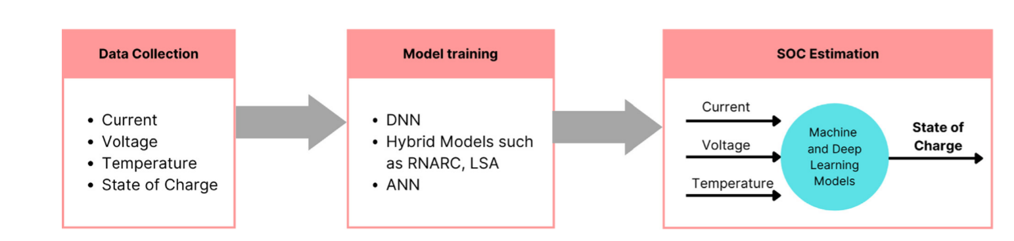
State of Charge (SOC) Estimation using AI
Ref https://www.sciencedirect.com/science/article/abs/pii/S1755008422000436

Slide 8
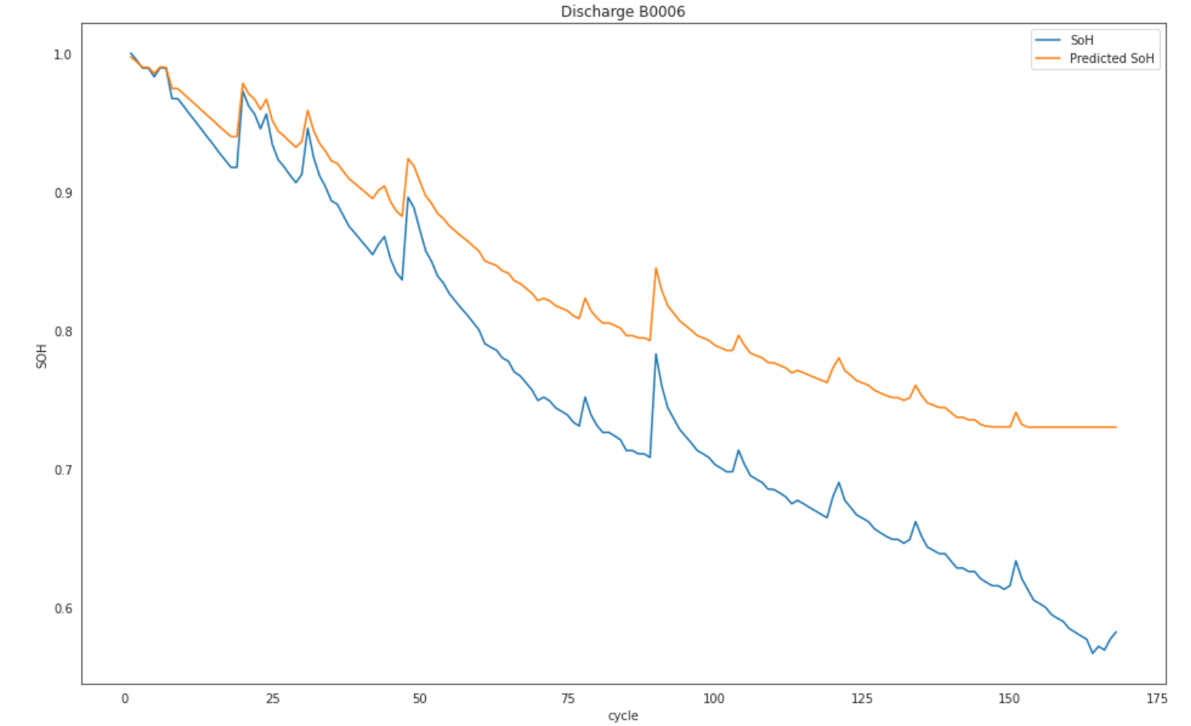
State of Charge (SOH) Estimation using AI

Slide 9
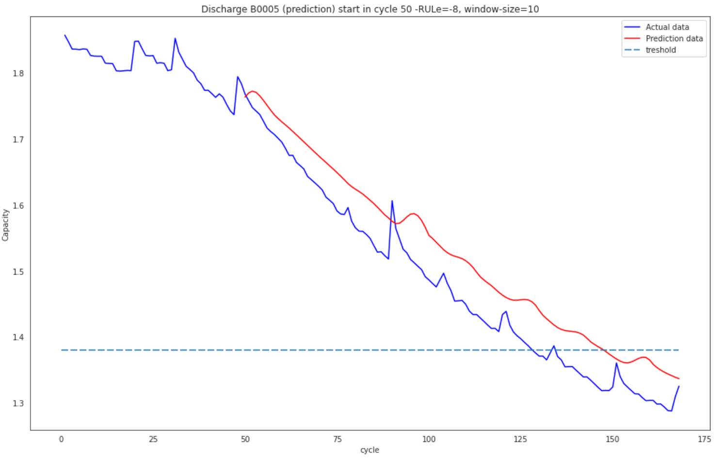
Remaining Useful Life(RUL) Prediction

Slide 10
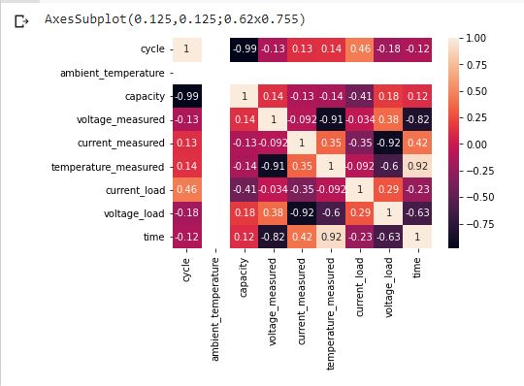
Heatmap
Voltage_measured is highly negatively related to temperature_measured
Ref https://www.kaggle.com/datasets/utsavk02/battery-data-set

Slide 11
Data Fields for Telemetry Analysis
cycle: top level structure array containing the charge, discharge and impedance operations
type: operation type, can be charge, discharge or impedance
ambient_temperature: ambient temperature (degree C)
time: the date and time of the start of the cycle, in MATLAB date vector format
data: data structure containing the measurements
for charge the fields are:
Voltage_measured: Battery terminal voltage (Volts)
Current_measured: Battery output current (Amps)
Temperature_measured: Battery temperature (degree C)
Current_charge: Current measured at charger (Amps)
Voltage_charge: Voltage measured at charger (Volts)
Time: Time vector for the cycle (secs)
for discharge the fields are:
Voltage_measured: Battery terminal voltage (Volts)
Current_measured: Battery output current (Amps)
Temperature_measured: Battery temperature (degree C)
Current_charge: Current measured at load (Amps)
Voltage_charge: Voltage measured at load (Volts)
Time: Time vector for the cycle (secs)
Capacity: Battery capacity (Ahr)
for discharge till 2.7V
for impedance the fields are:
Sense_current: Current in sense branch (Amps)
Battery_current: Current in battery branch (Amps)
Current_ratio: Ratio of the above currents
Battery_impedance: Battery impedance (Ohms) computed from raw data
Rectified_impedance: Calibrated and smoothed battery impedance (Ohms)
Additional Data
Humidity: Humidity of environment
Tire Traction: Under-inflated tires, wear out tires
High Speed: High Speed
Payload: Motor has to work to offset to weight
Terrain: Climbing terrain

Slide 12
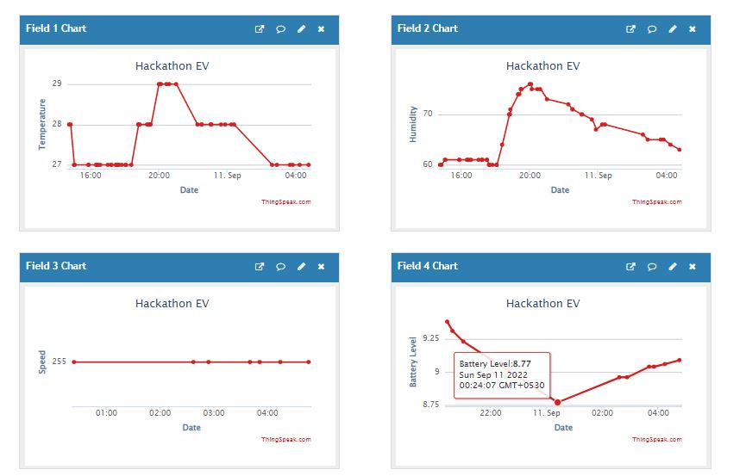
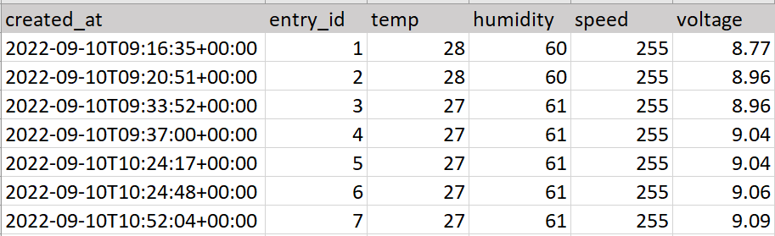
Demonstration of Data Collection using IoT

Slide 13
Risk Calculation Hypothesis
Using RUL Prediction
No. of Charging Cycle of Battery: P Cycles
No. of Elapsed Charging Cycle of Battery: E Cycles
No. of Months it took to discharge to Level ‘E’ : M months
Predicted Elapsed Charging Cycle left in Battery (RUL): L Cycles
Degradation rate per month = E/M = D rate
Remaining time left (Considering Usage Patter) : (P-L)/D months
Similar degradation rate can be calculated using SOH Prediction

Slide 14
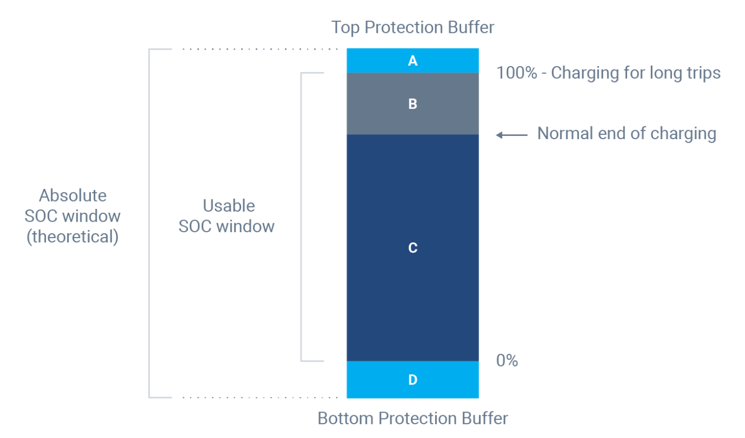
Why does warranty life can not be only measure to evaluate Risk ?
As Battery protection buffers control the usable state of charge window for an EV, only Telemetry data analysis of battery and Over-the-Air Updates of firmware can change the protection buffers in order to expand battery RUL.
Frequency of full charge cycle (Usage) can vary from a personal EV and public EV (Cabs), which directly reduces the RUL of Battery. (Warranty Adjustment)

Slide 15
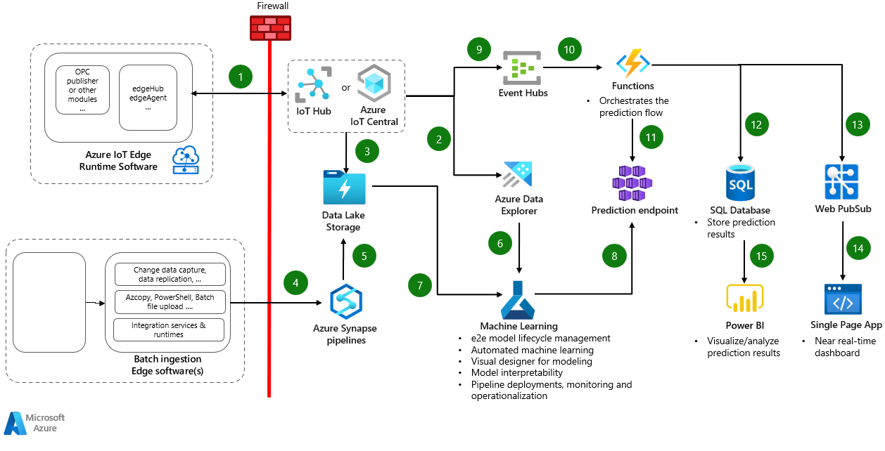
For Real Time/Batch Telemetry Data Analysis
Realtime Telemetry Data of EV
Offline Generated Data Sync (Batch) of EV
Battery Telemetry, Driving Behaviour, Ambient Temperature and Humidity etc.
Azure Cloud Architecture

Slide 16
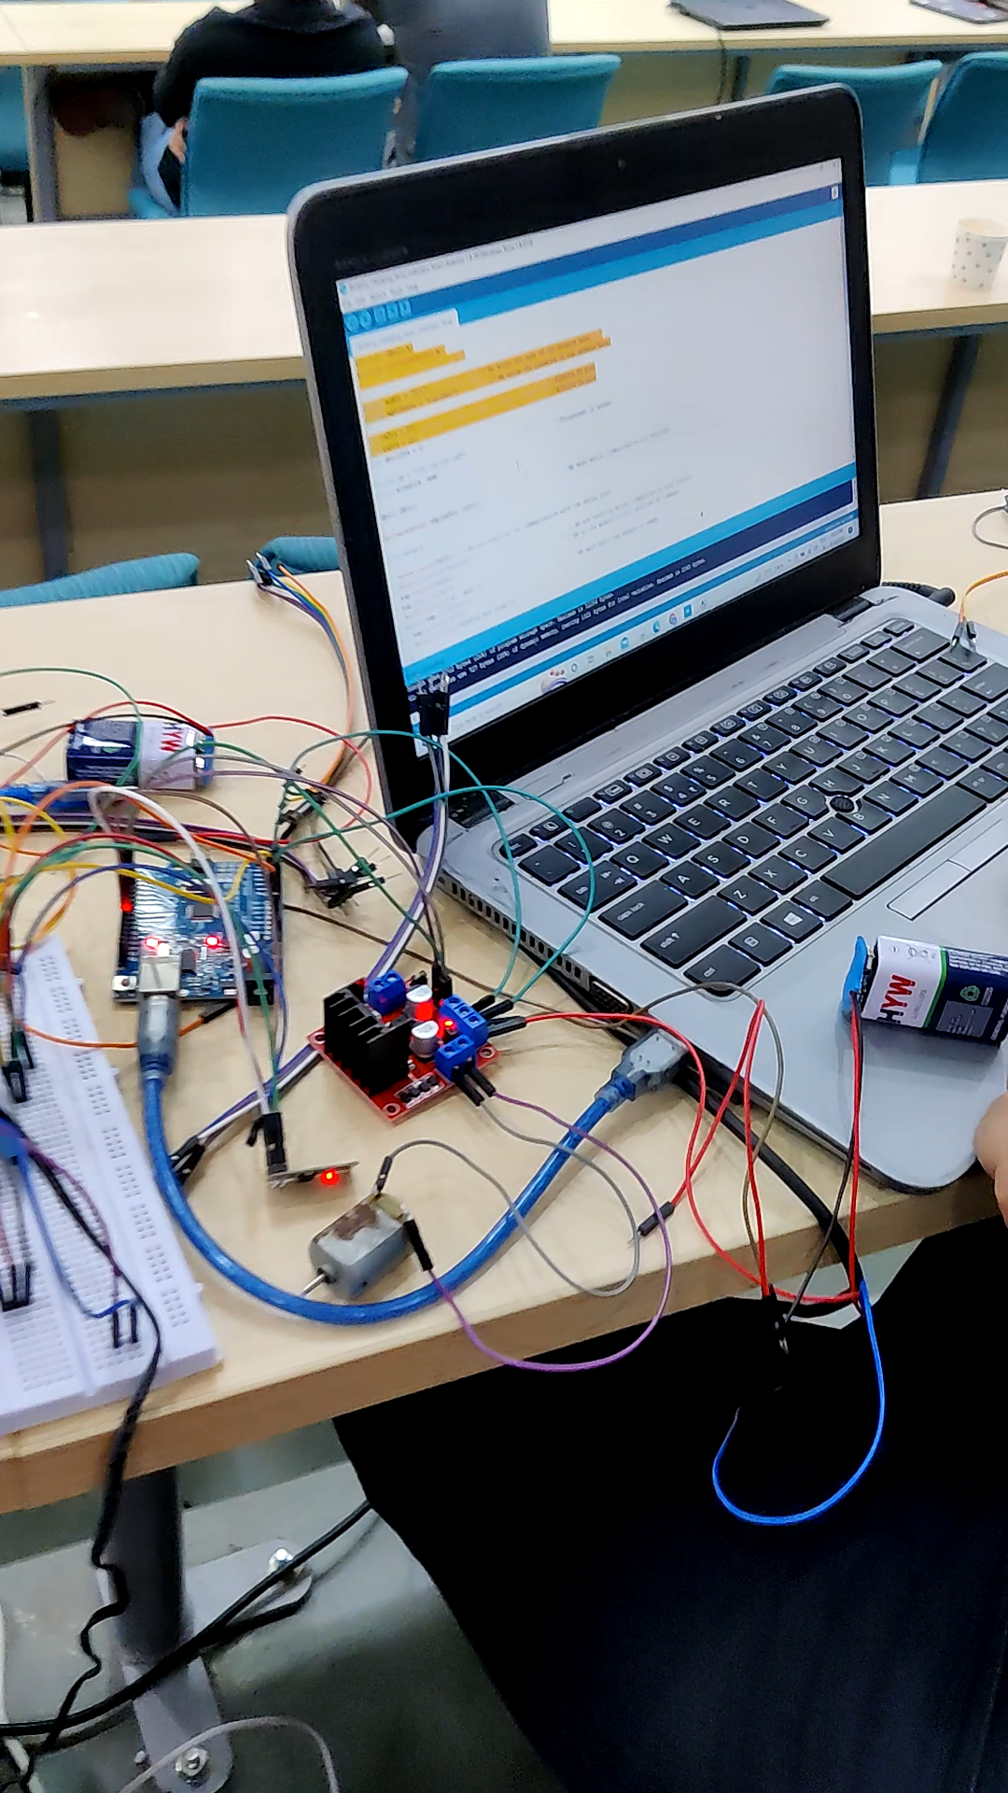
For Real Time/Batch Telemetry Data Analysis
Demonstration of IoT Setup with varied speed

Slide 17



Team Members
Software/Data Engineer | GCP Data Engineer Certified | Azure Data Engineer Certified
Data Scientist | Senior Technical Lead | Senior IoT & AI Product Development Advisor

Slide 18
Thanks

